Slide 1
Logic_Backplane_PCB v1
Joey, Youngwoo
2022.06.28

Slide 2
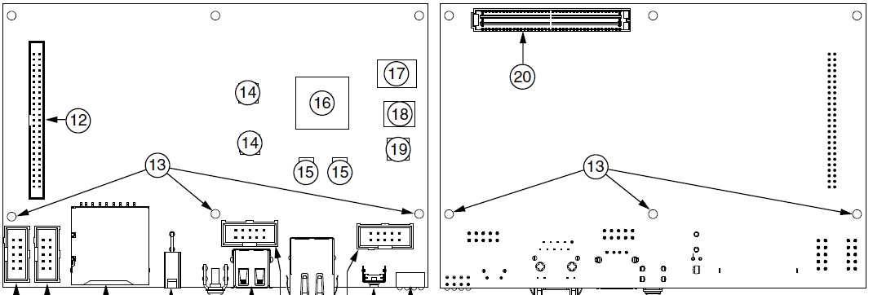
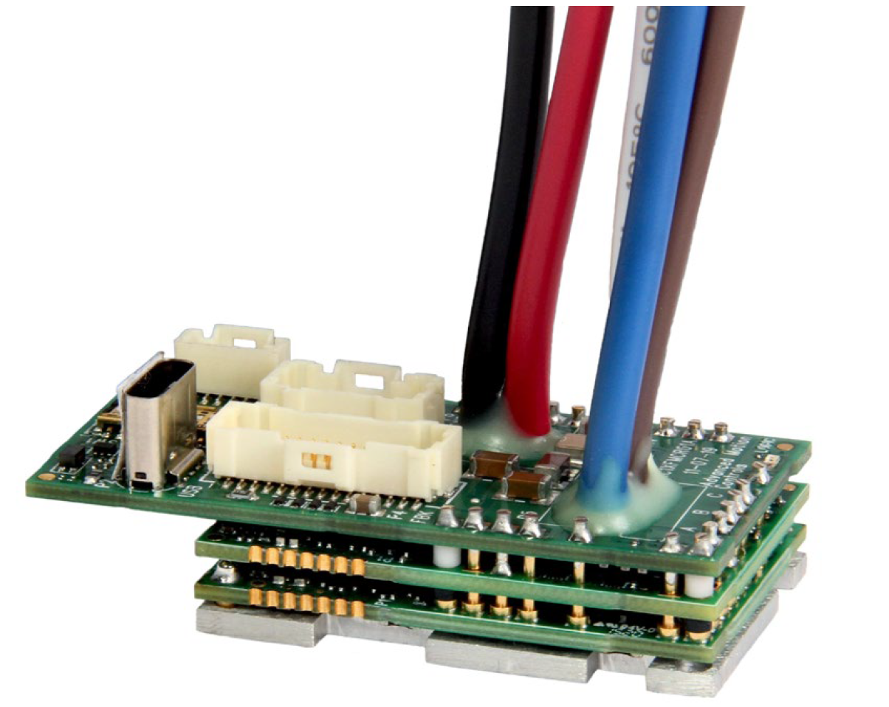
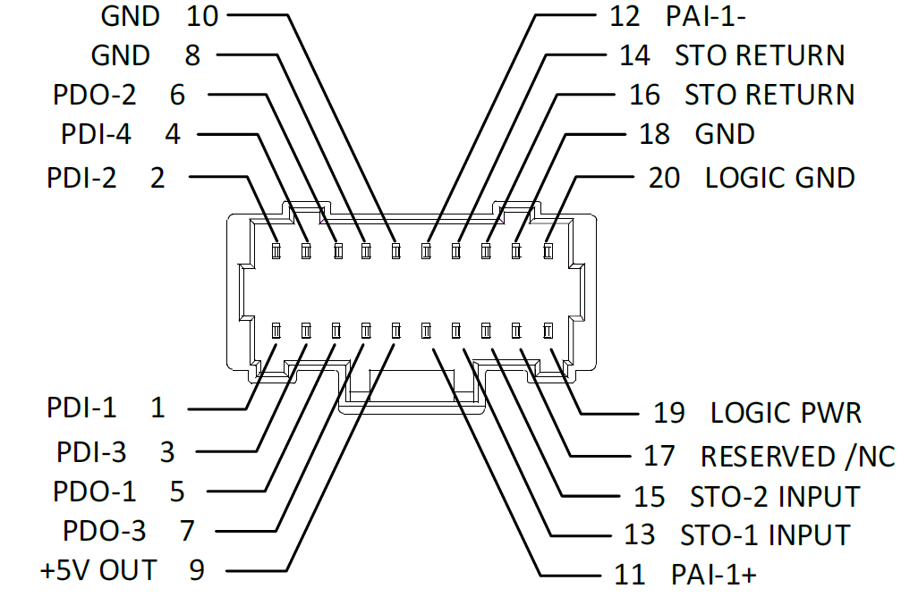
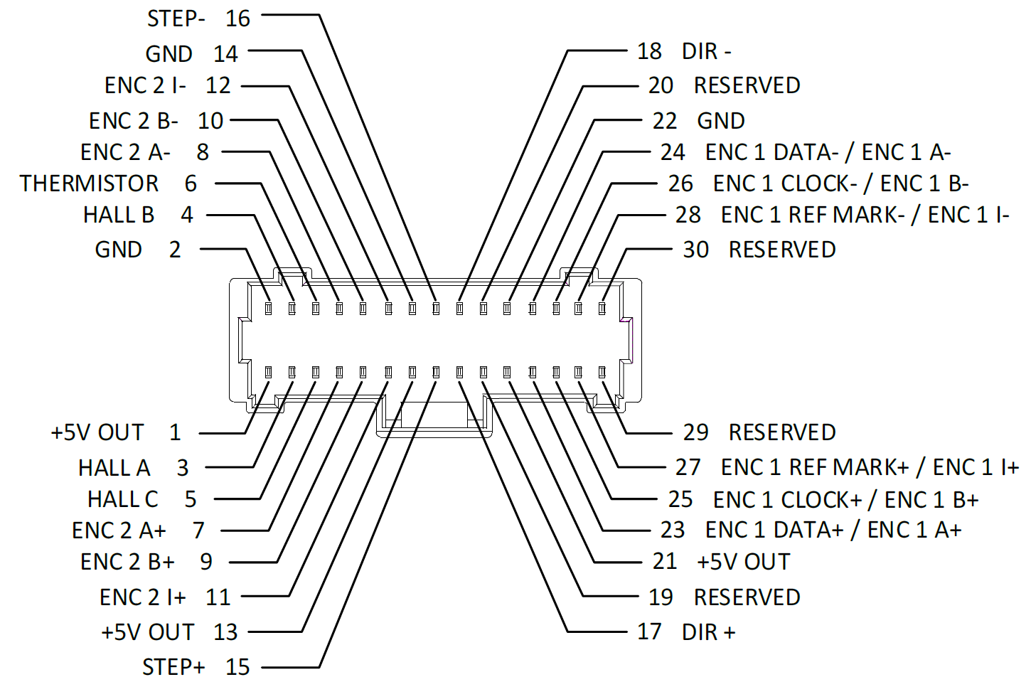
Goal
Establish connection between
sbRIO FPGA pins
10x AMC motor drivers
10x BiSS-C encoder
Safety Torque Off (E-STOP capability)

Slide 3
Connection
Not displayed: E-stop, Motor Driver Power Conn.
Analog Out
to Motor Driver
Motor Driver
sbRIO
BISS-C
Encoder
BISS-C
Encoder
Logic Backplane
BISS-C
Encoder
C-Series
Module
Analog
8 Position
MotorDrv
Conn.
MotorDrv
Conn.
MotorDrv
Conn.
MotorDrv
Conn.
Encoder Conn.
Encoder Conn.
BiSS-C
Encoder
Encoder Conn.
BISS-C
Encoder
Encoder Conn.
BISS-C
Encoder
BISS-C
Encoder
10 Position
FPGA
SEARAY 240pin

Slide 4
Where are the connectors? - sbRIO
sbRIO
FPGA
SEARAY 240 pin
DIO
50 pos IDC 2mm
Primary Side
Secondary Side

Slide 5
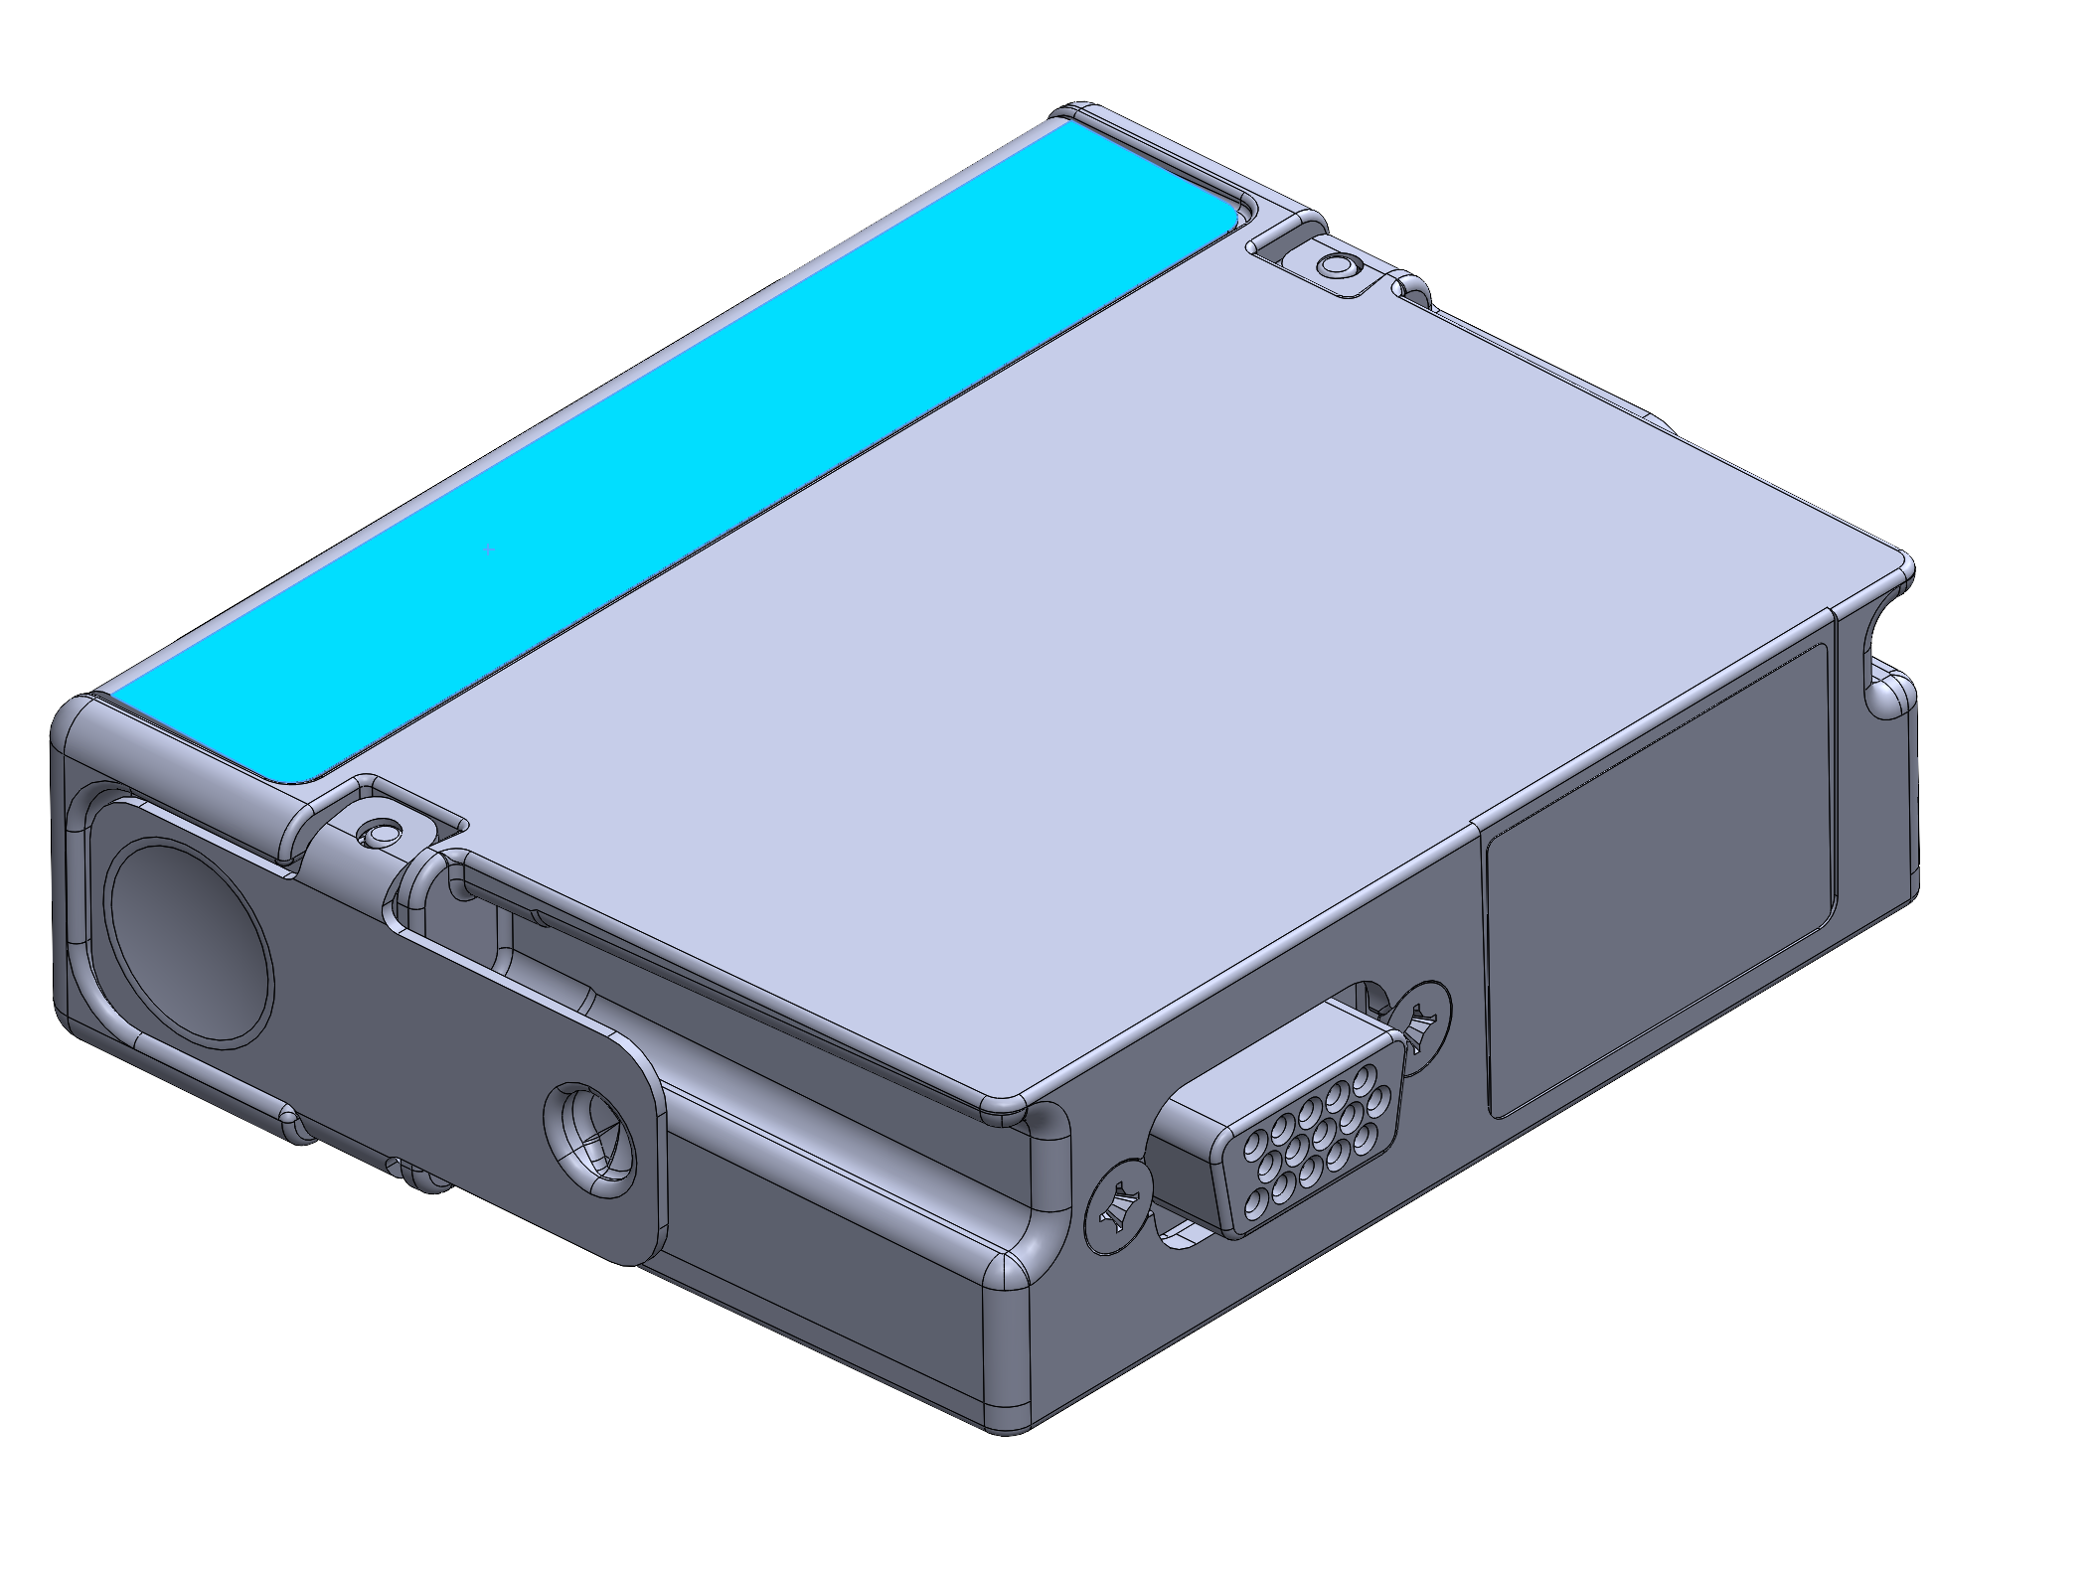
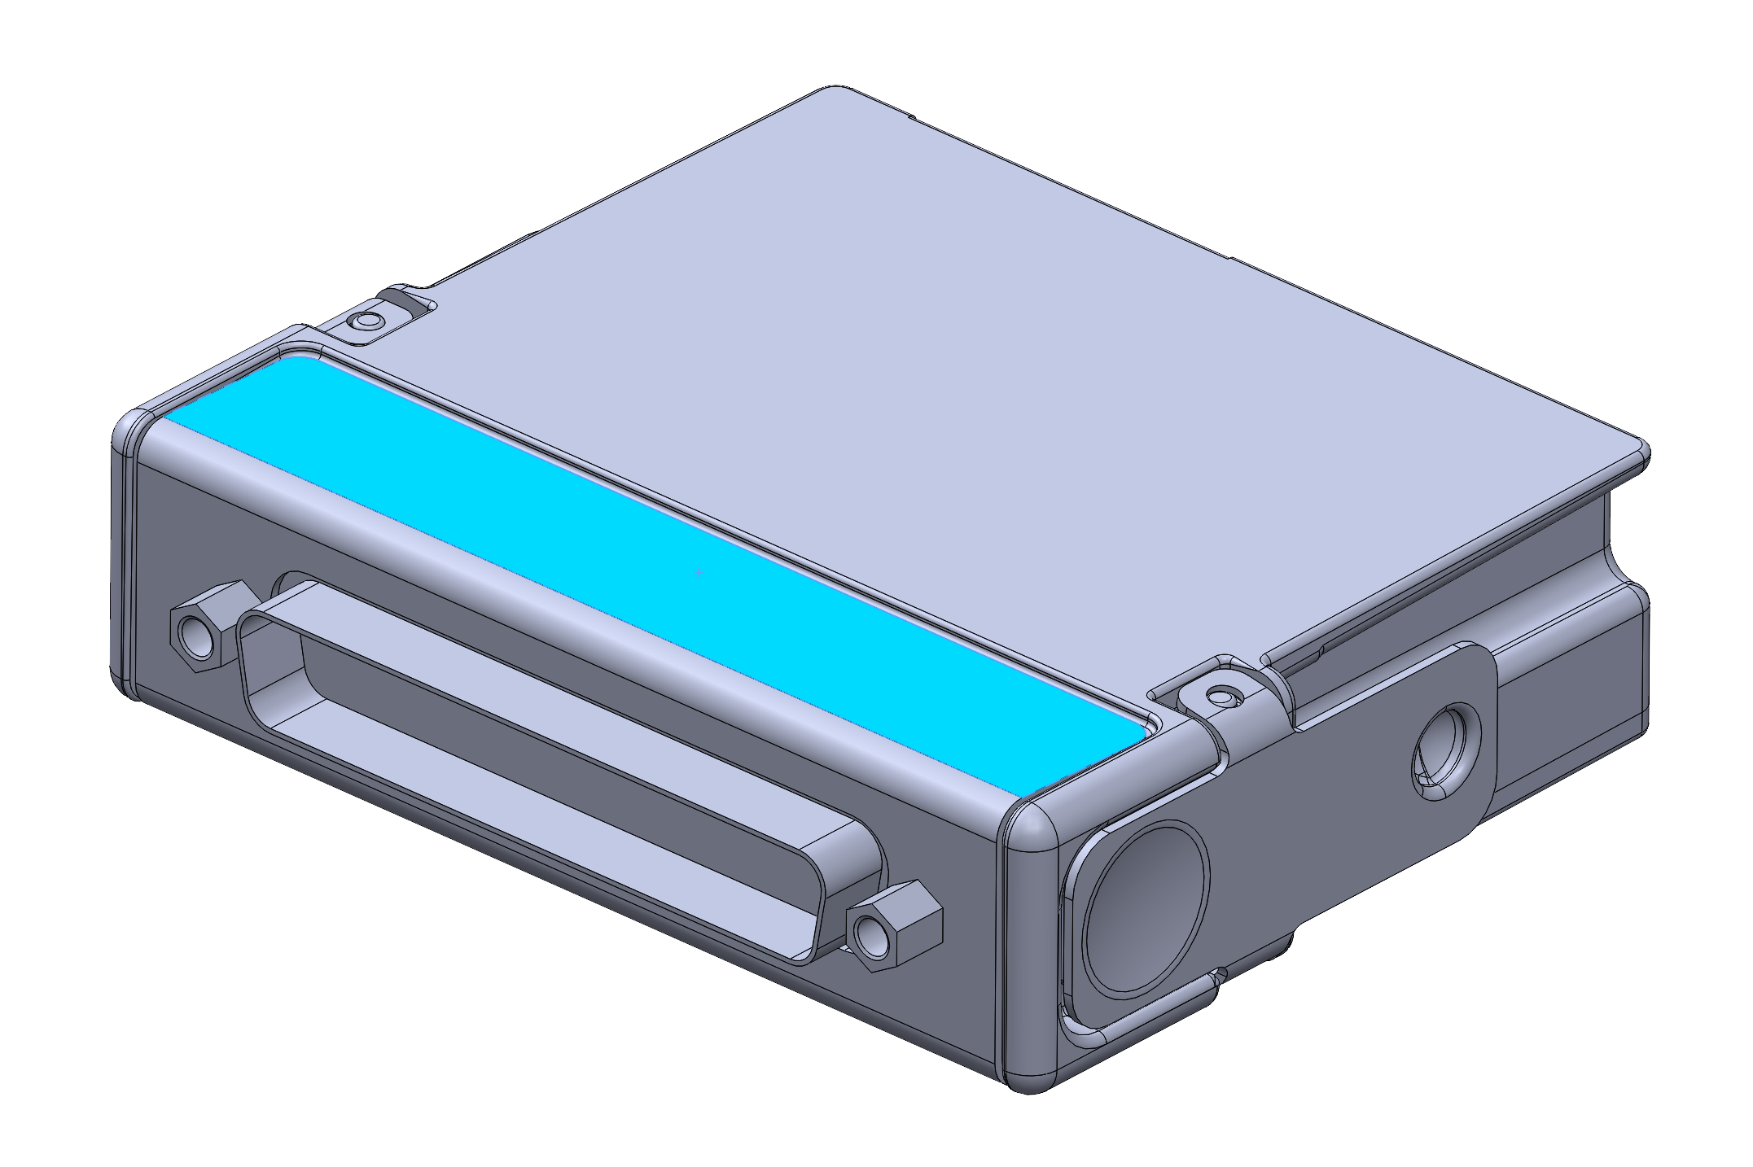
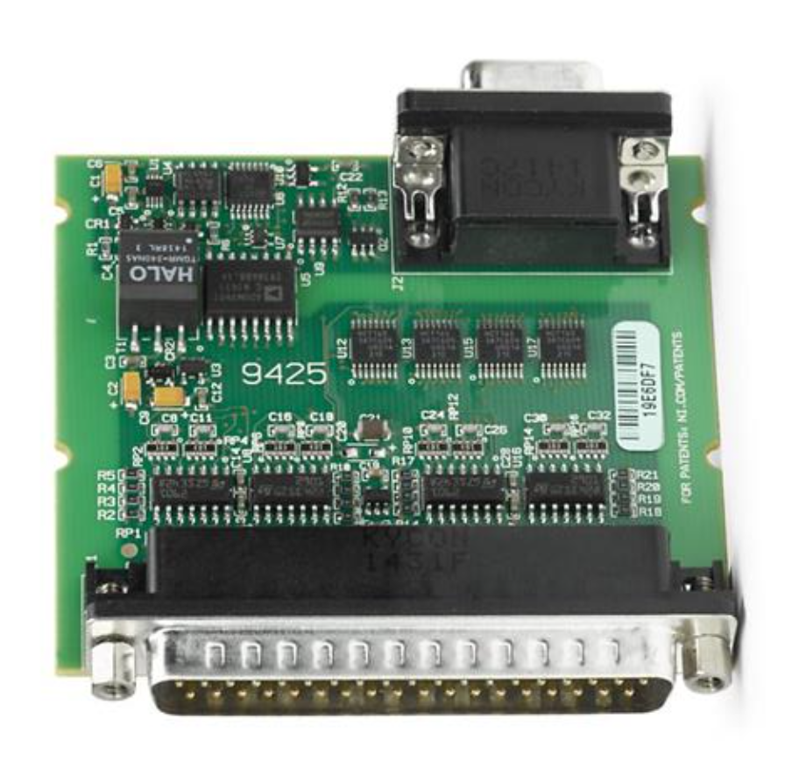
Where are the connectors? – C-Series module
Conn. to FPGA
High-Density D-Sub 15 Pos
Female
Analog Outputs
to Motor Drivers
D-sub 37 pin
Without Cover

Slide 6
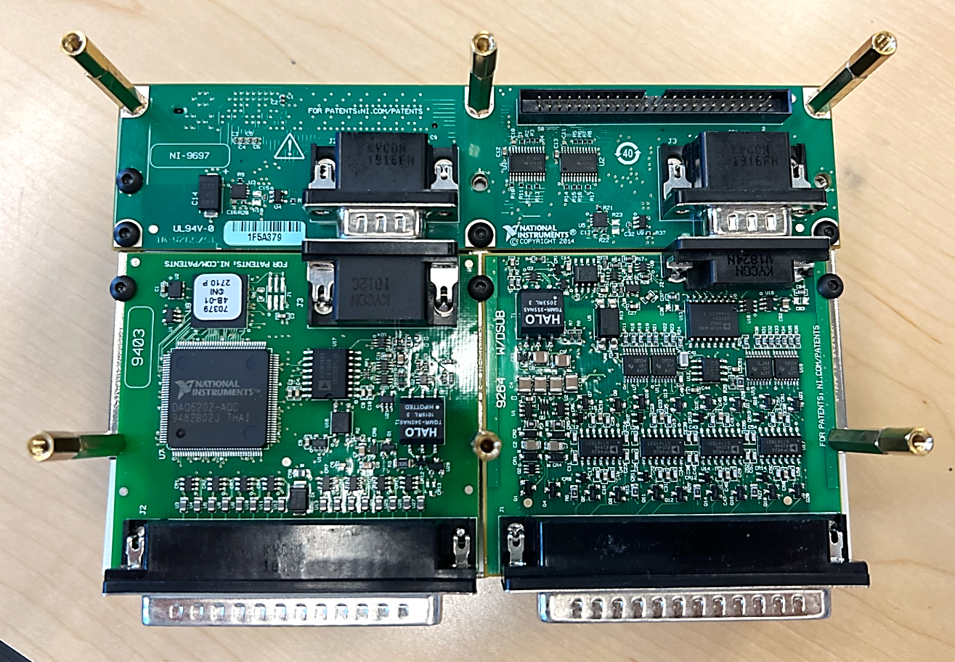
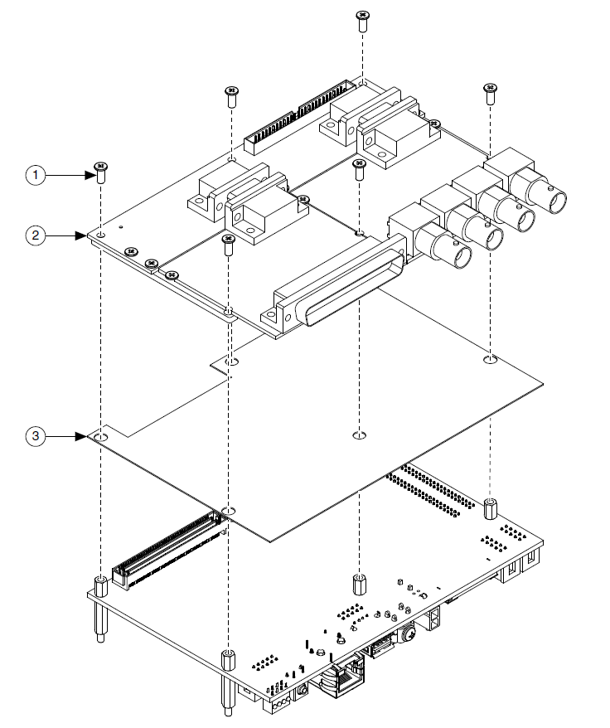
Where are the connectors? C-Series Module
C-Series module is attached on RIO mezzanine card,
FPGA
SEARAY 240 pin
C-Module Conn.
C-Series Module
(Slot 2)
C-Series Module
(Slot 1)
C-Series Modules
Module mounting example
Module mounting example

Slide 7
Where are the connectors? C-Series Module
Our logic backplane PCB will replace the RIO mezzanine card
Mating with sbRIO via Backplane PCB
Attaches on the Secondary side
Logic Backplane
PCB
C-Module Conn.
1x C-Series Module
FGPA Conn.
Hidden from this view
RMC Conn.
(Mounted on Secondary Side)
sbRIO
(Secondary side up)

Slide 8
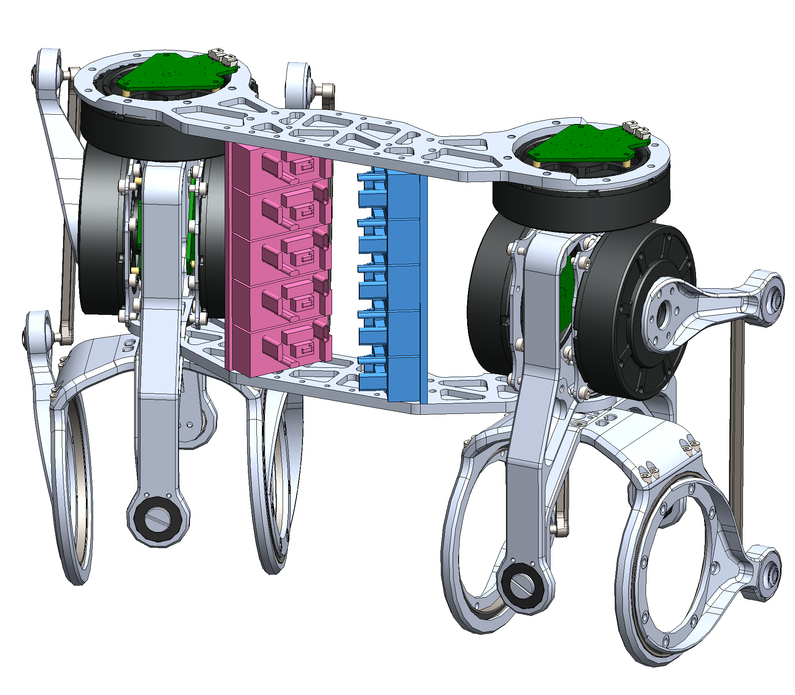
Where are the connectors? – AMC Driver
Pico-Clasp 30 Pos
Enc Fdb
Pico-Clasp 20 Pos
Safety torque off (e-stop)
Analog IN

Slide 9
Connection Contents
Connections between backplane back and
sbRIO
C-module
Encoder
Motor driver
DIO breakout
Power consideration

Slide 10
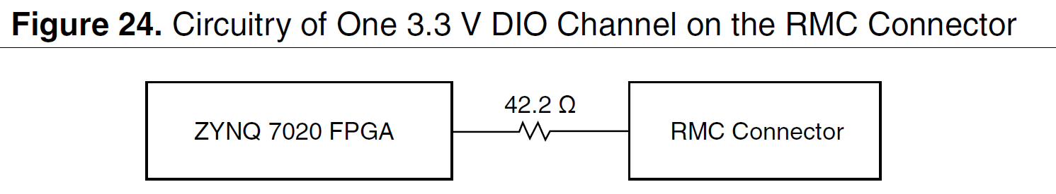
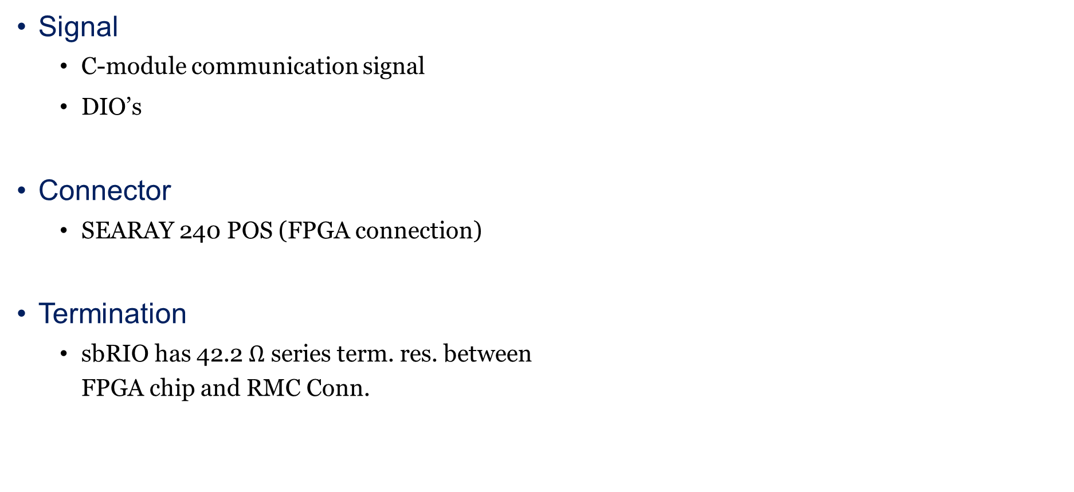
Connection: Logic Backplane PCB – with sbRIO
Signal
C-module communication signal
DIO’s
Connector
SEARAY 240 POS (FPGA connection)
Termination
sbRIO has 42.2 $Ω$ series term. res. between FPGA chip and RMC Conn.
Logic Backplane
PCB
SEARAY 240 pin FPGA Conn.
Hidden from this view
SEAM-40-03.0-
S-06-2-A-K-TR
RMC Conn.
(Mounted on Secondary Side)
sbRIO
(Secondary side up)
SEAF-40-06.5-
S-06-2-A-K-TR

Slide 11
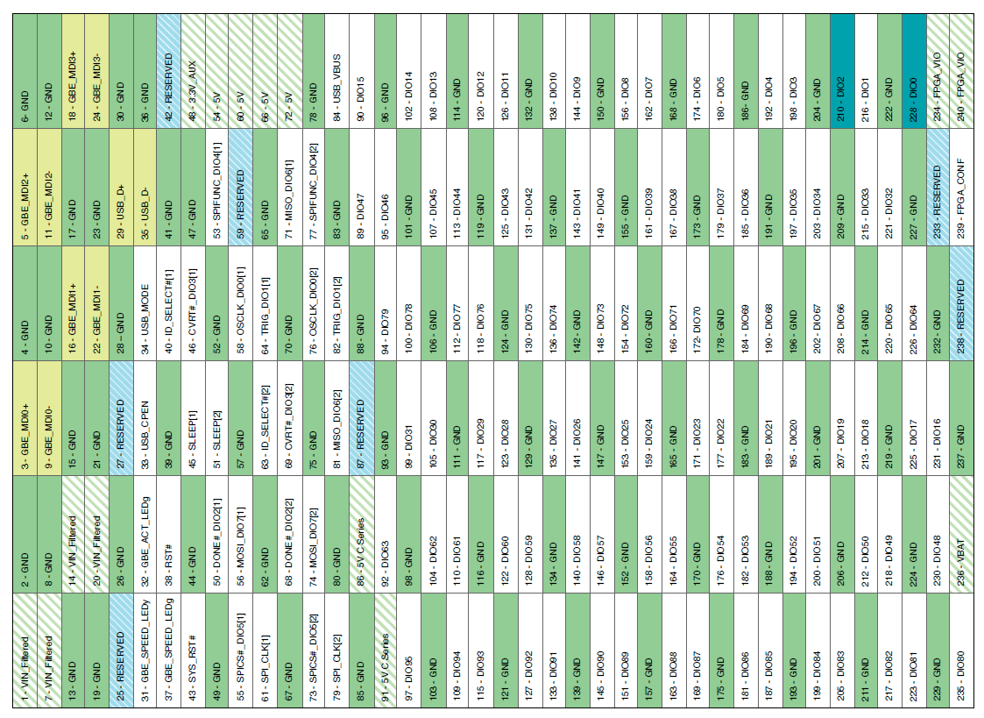
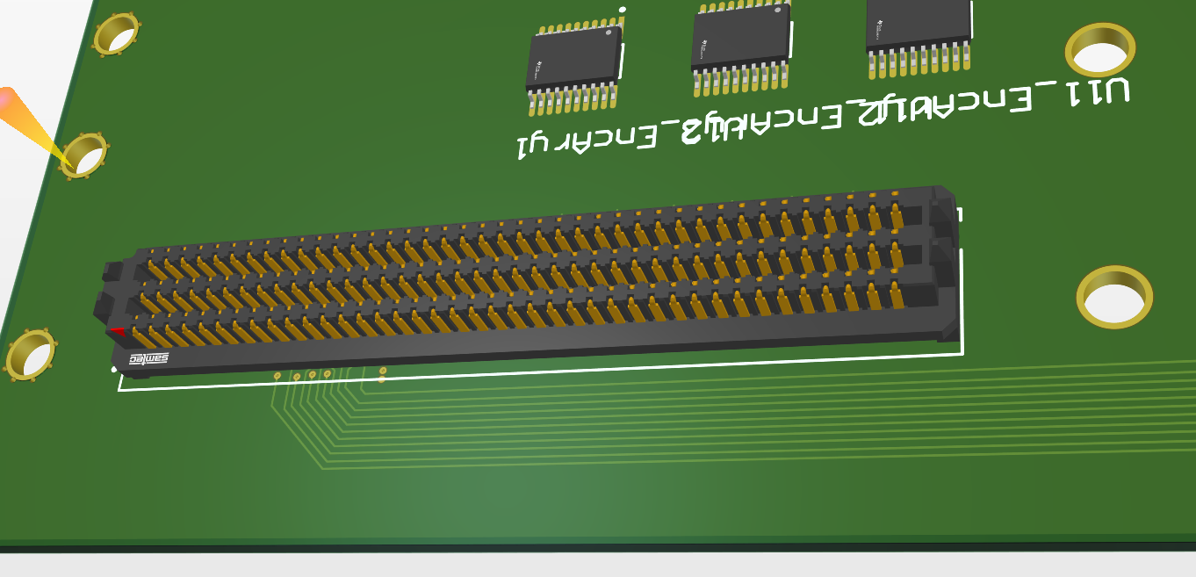
Connection: Logic Backplane PCB – with sbRIO
Pin Map (from sbRIO user manual)
Pin 6
Pin 240
FGPA Conn.
Hidden from this view
Pin 1
DIO[0..15]
DIO[31..47]
DIO[64..79]
Pin 240
DIO[16..31]
Pins for C-Series Module Comm.
+ 5V/3V3…
DIO[48..63]
DIO[81..95]
Pin 1
Pin 235
Pin 240
Edge of the board. Notice how pin 1, 7, …, 235 are closer to the board edge
Pin 1

Slide 12
Connection: Logic Backplane PCB – with C-module
Connector geometry and choice are already determined.
Notice that the board is cut away to mount that bulky c-module.
FGPA Conn.
Hidden from this view
Logic Backplane
PCB
C-Module Conn.
1x C-Series Module
sbRIO
(Secondary side up)

Slide 13
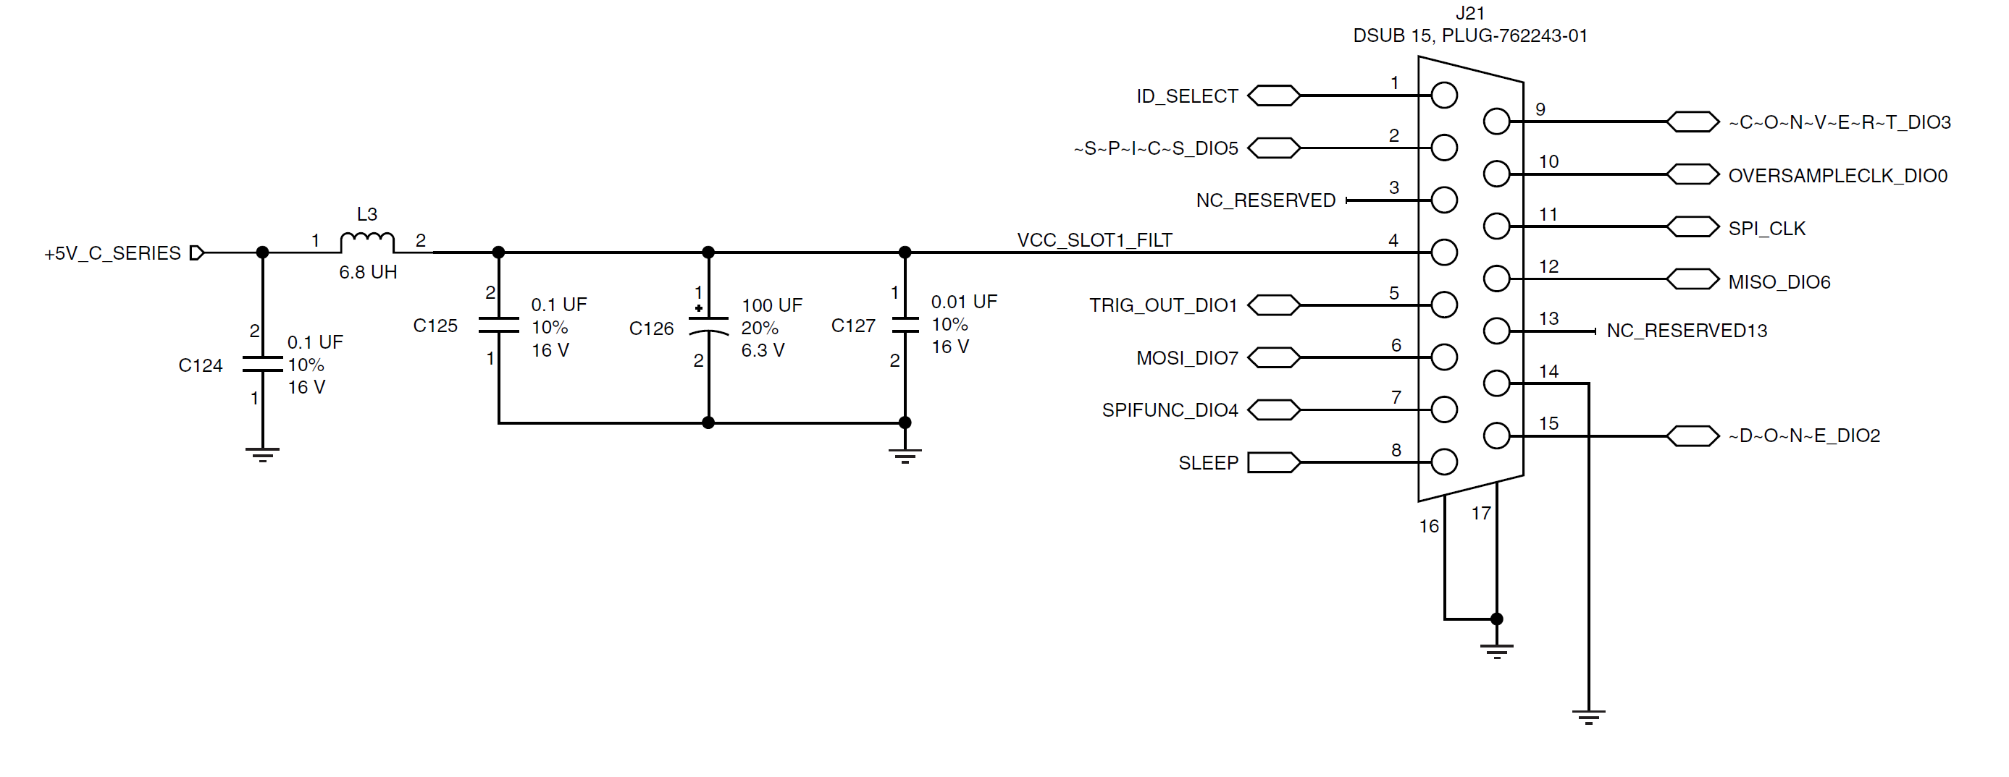
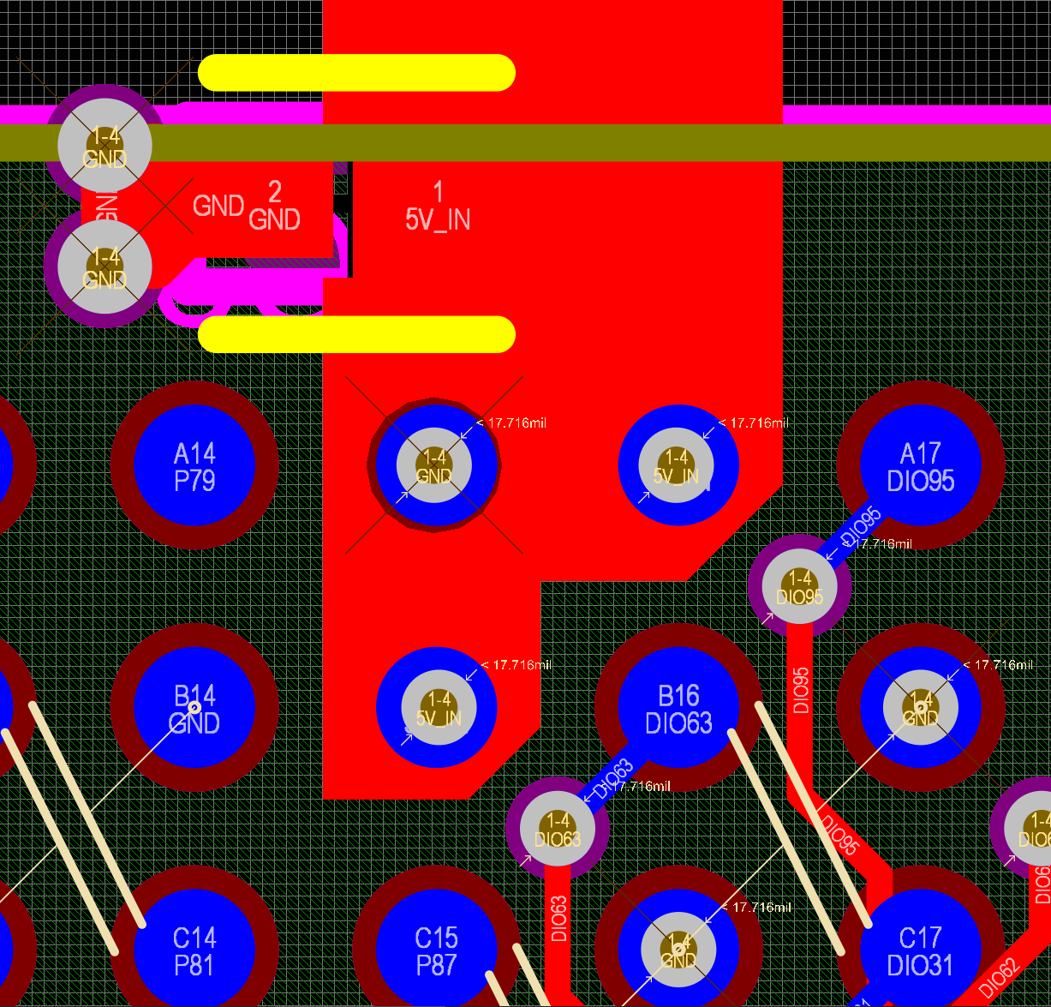
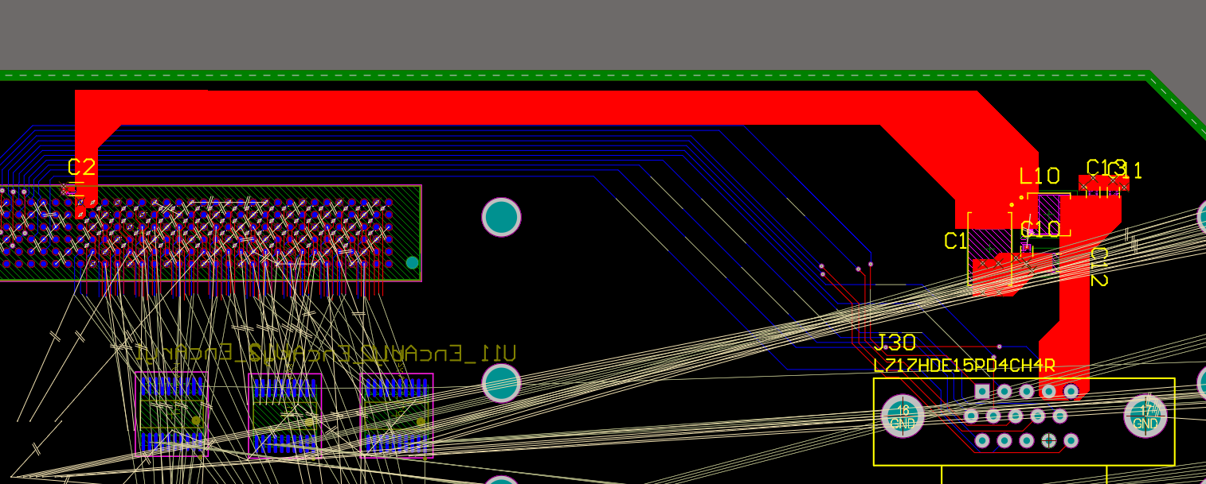
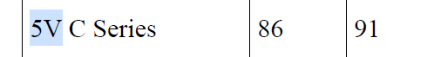
Connection: Logic Backplane PCB – with C-module
Refer to p.18~20 of mezzanine card design guide for schematic
There are two options: 1) with current limiter and 2) without. Let’s go with 2)
Although there’s official design guide, NI-9697 implementation differs slightly
A couple of caps which is not described in design guide
+5V_C_SERIES
* I tried replicating NI-9697 myself
Dedicated 5V
for C-modules
(pin 86, 91)
VCC_SLOT1_FILT

Slide 14
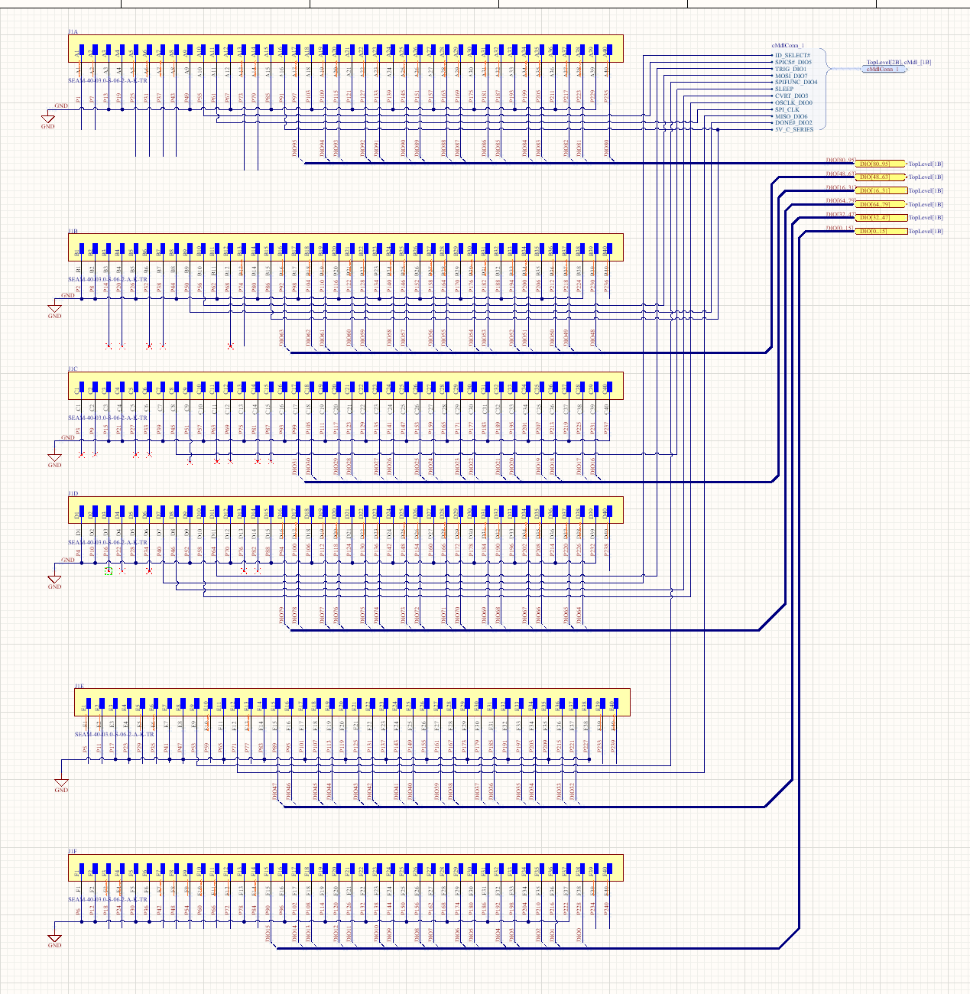
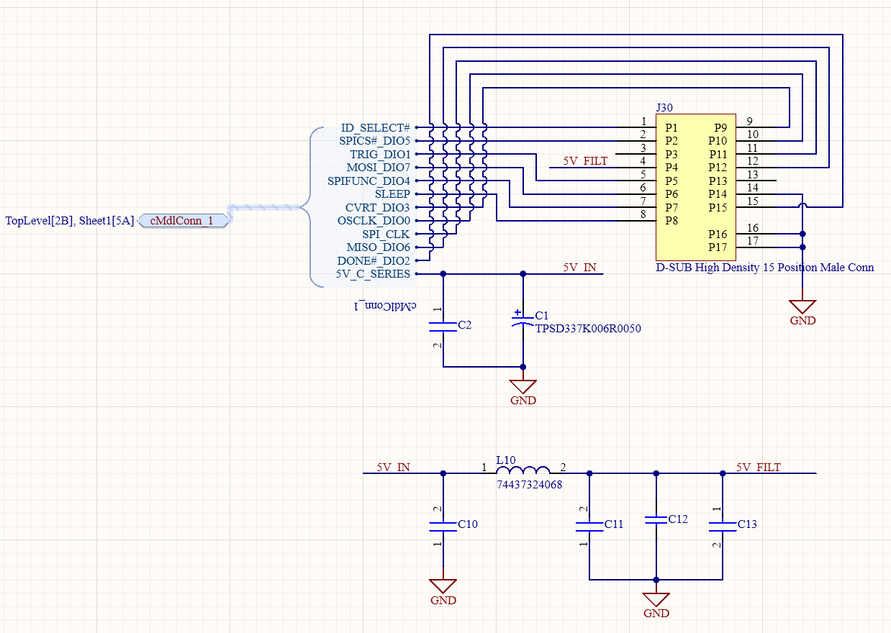
Connection: Logic Backplane PCB – with C-module
Altium has schematic symbol, but row-column-majorness differs from pinmap in sbRIO user manual, be aware.
Below is what I did
D-sub HD 15 Pos Male
Pin 1
Pin 235
C-Module Pins
Buses of DIO in 16 bits
(x6) SEARAY connector
PWR Filter
Pin 6
Pin 240

Slide 15
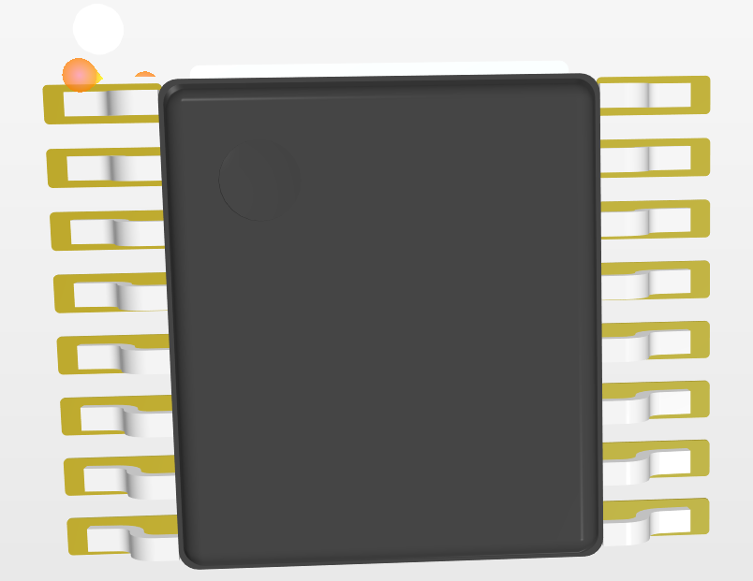
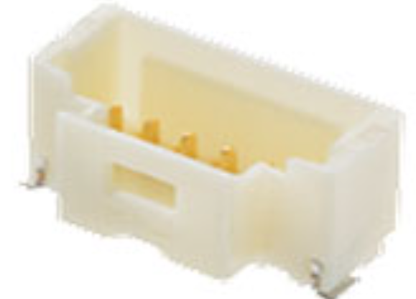
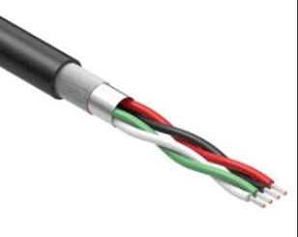
Connection: Logic Backplane PCB - Encoder
40x DIO needed to read single-ended (A/B/MA/SLO) from encoder PCB
AM26LV32E(AM26LV32EIPWR)
Quad diff line receiver
Logic Backplane
PCB
PicoClasp Receptacle
10 Position, Right Angle
sbRIO
(Secondary side up)
Custom Cable (probably)
10 Position
- A, NA, B, NB, MA, NMA, SLO, NSLO, 5V, GND
BiSS-C Encoder
PCB v2

Slide 16
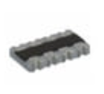
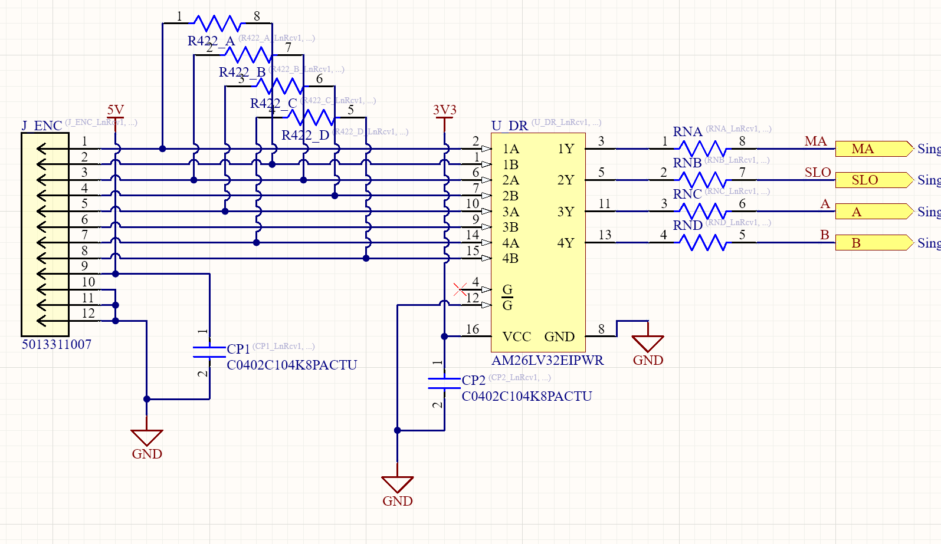
Connection: Logic Backplane PCB - Encoder
AM26LV32E(AM26LV32EIPWR)
Quad diff line receiver
100 ohm
Receiver-end termination
(CTS 742C083101JP)
PicoClasp Receptacle
10 Position, Right Angle
(5013311007)
I’m not sure of this
Series termination (not sure..)
47 ohm (close to 55?)
(742C083470JP)
Incoming enc. fdb. sig. Differential RS-422
Termination/conversion
Single –ended A/B/BiSS-C
to FPGA DIO

Slide 17
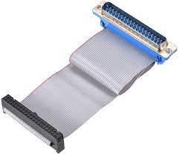
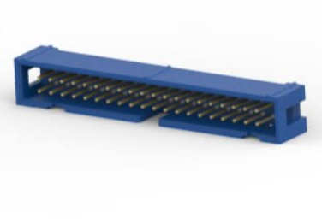
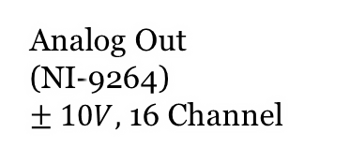
Connection: Logic Backplane PCB – Motor Driver
Communicate with motor driver
PicoClasp Receptacle
8 Position, Right Angle
Logic Backplane
PCB
Analog Out (NI-9264)
$± 10V,$ 16 Channel
Pin 1
DB37 – IDC 40 pos 2.54mm Ribbon Cable
- 16ch (ANA+/ANA-)
Pin 1
Cable to AMC Driver
8 Position
MA/NMA/SLO/NSLO
ANA+/ANA-
STO1/STO2 (e-stop switch)
IDC 40 pos 2.54mm header
Polarized
I’m not sure of orientation, tbd

Slide 18
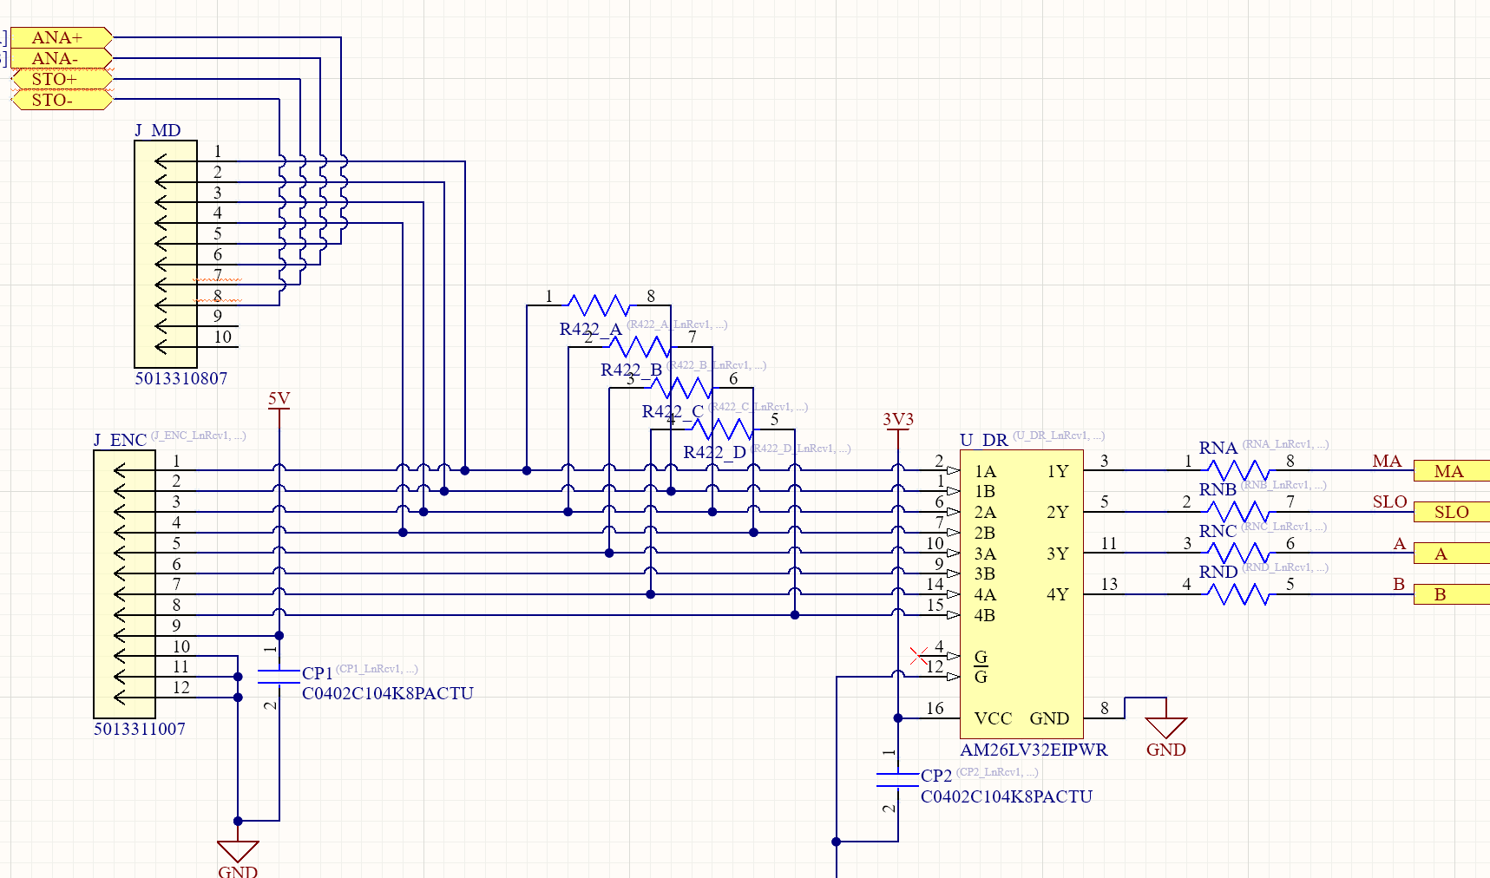
Connection: Logic Backplane PCB – Motor Driver
Communicate with motor driver
PicoClasp Receptacle
8 Position, Right Angle
Analog output
from C-module
STO jumper
This portion is added on the previous schematic

Slide 19
Connection: Logic Backplane PCB – Motor Driver
STO implementation
STO+ and STO- of each driver needs to be shorted for proper operation
When STO+ and STO- are disconnected, the driver powers off
Single switch for multi-STO implementation
We short STO1+, … , STOn+ on the pcb.
Do the same for (-) signals too.
Place a 2-pin connector with positive lock
Pin1: STO+[1..n]
Pin2: STO-[1..n]
Later, an E-stop switch can be connected between pin1 and pin2.

Slide 20
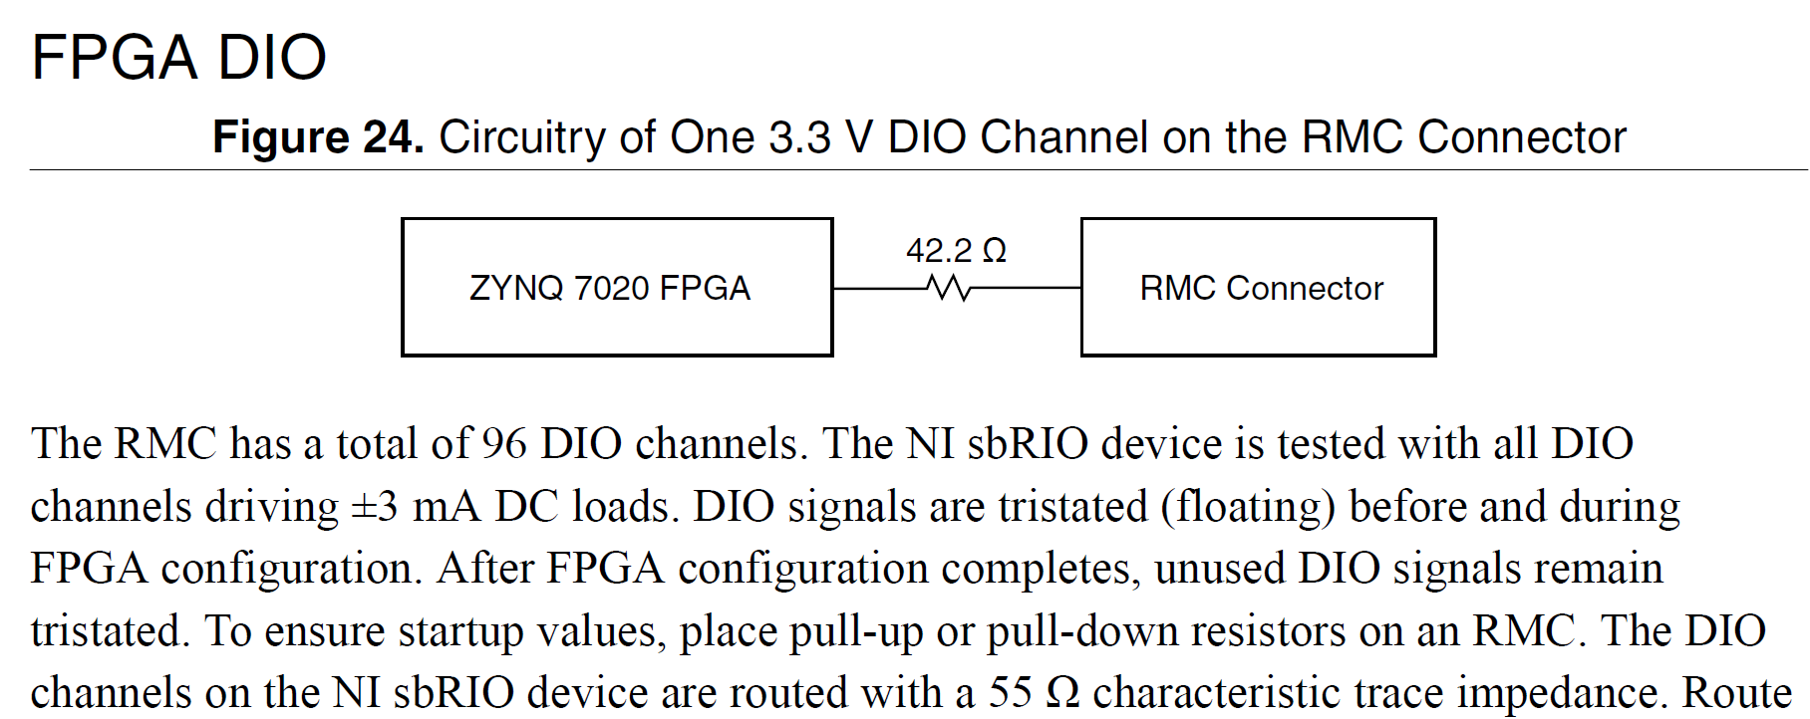
Connection: Logic Backplane PCB – DIO breakout
So far, 40x DIO were allocated for encoder reading
There are (96-40) DIO remaining for breakout
sbRIO already has serial termination near FPGA-end (p.43 sbrio-9627 user manual)
So, what should go on the backplane pcb?
sbRIO PCB
Backplane PCB
ZYNQ 7020 FPGA
DIO
Contact
Mating Connector
??
Load/driver

Slide 21
Connection: Logic Backplane PCB – DIO breakout
So, what should go on the backplane pcb?
I analyzed NI’s mezzanine card design. Maybe we can follow their practice.
sbRIO PCB
Backplane PCB
ZYNQ 7020 FPGA
DIO
Contact
Mating Connector
??
Load/driver
sbRIO PCB
Backplane PCB
ZYNQ 7020 FPGA
DIO
Contact
Mating Connector
FET Bus Switch
Load/driver
NI uses SN74CBT3384C
(10 bit fet bus switch)
I guess it’s for protection.
I think 3.3V version is more adequate.. (SN74CBTLV3245A)
32 ohm (measured with DMM)
Thin film resistor, placed right next to the bus switch

Slide 22
Connection: Logic Backplane PCB – DIO breakout
Placement of breakout
Put headers as many as needed for breakout.
10+ position idc 2.54mm header double row
We can extend towards y (north) direction

Slide 23
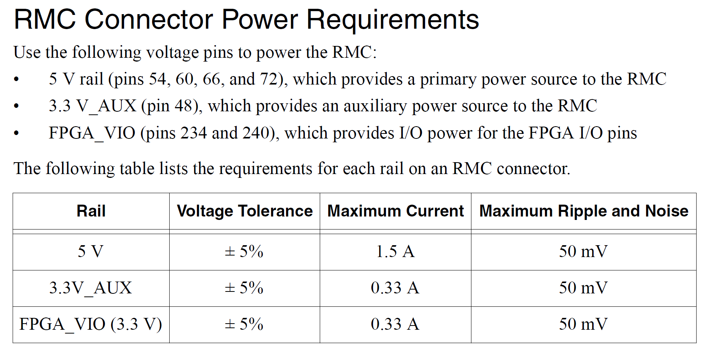
Connection: Logic Backplane PCB - Power
sbRIO offers some power thru RMC connector
Plz check if 1.5A@5V is enough to drive encoder 10x encoder PCBs
Plz check if 0.3A@3.3V is enough for 20+ differential line receivers (probably not)
Not quite sure if we can use this

Slide 24
Connection Summary
DIO breakout
IDC 2.54mm double row headers as many as needed
Y-dir dimension is expandable
SEARAY
FPGA RMC mating Conn.
C-module connector
C module
place
10x
Array of connectors to AMC driver & encoder pcb, line receiver, decoupling cap, termination..
(Option1)
Analog signal from c-module
(Option2)
Analog signal from c-module

Slide 25
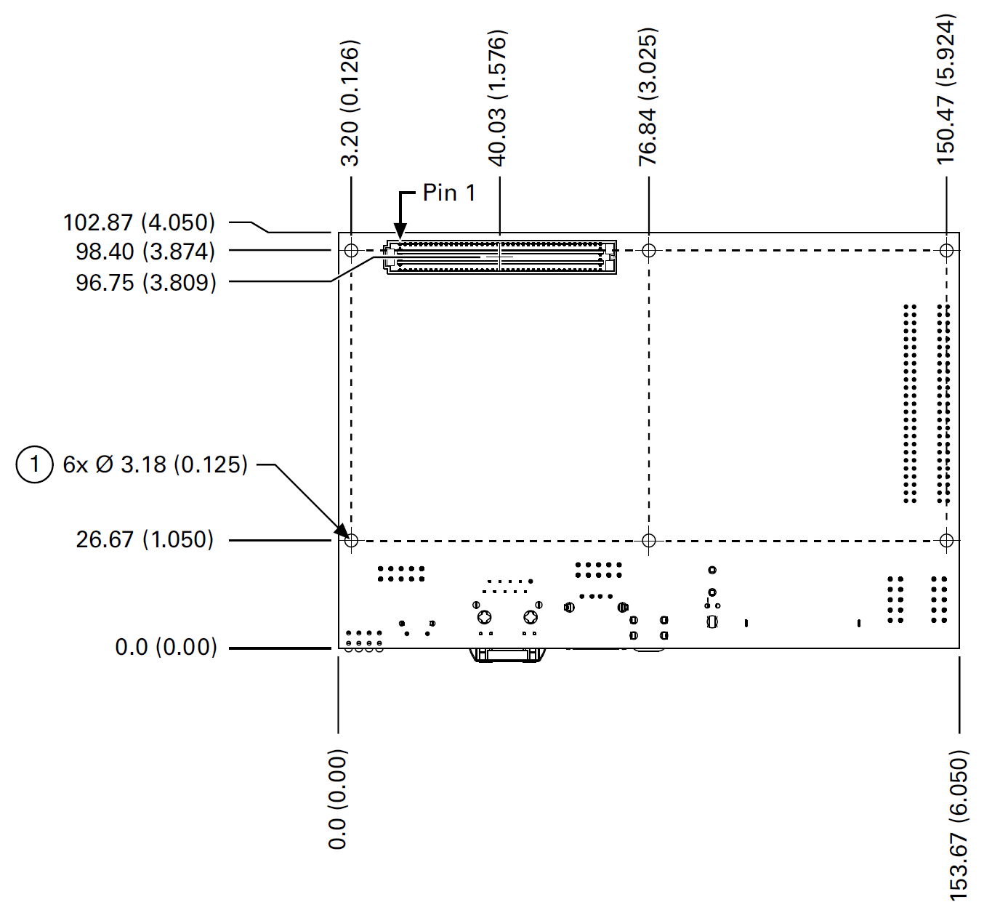
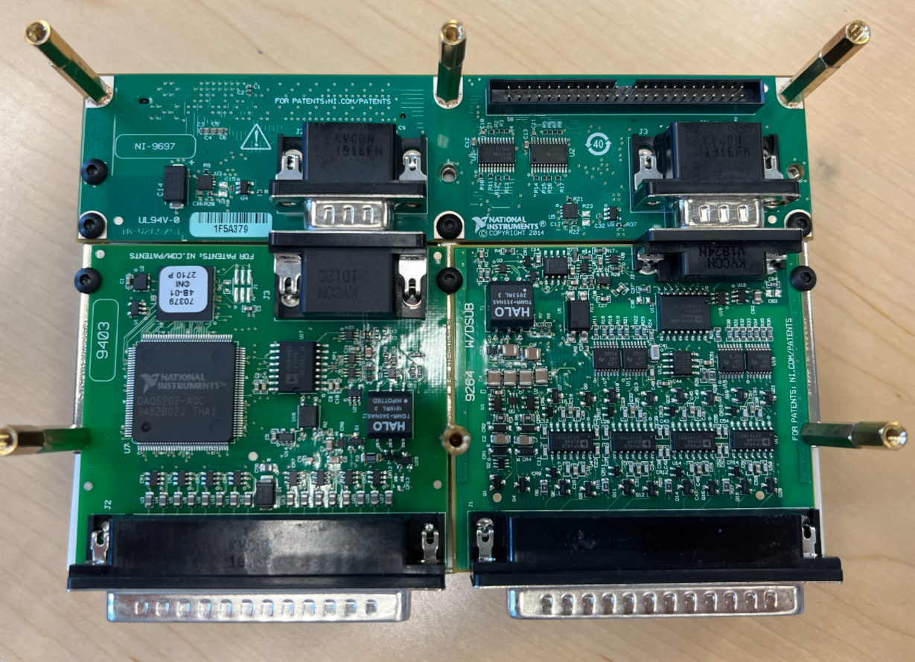
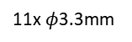
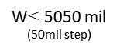
PCB Holes / Max.Min. Conditions
Refer to p.5, p.7 of sbrio-9627 user manual
150mil
11x $φ$3.3mm
W$≤$5050 mil
(50mil step)
3874mil
L717HDE15PD4CH4R
Male
L717HDE15PD4CH4R Datasheet (PDF)
3066 mil
2744mil
TBD
1050mil
0.0
0.0
2990mil
3025mil
5637mil
126mil
5924mil
6050mil

